Slide 1
AKS- Persistent Volume Store
Notes:
These Learn modules are part of the AZ-204: Implement Azure App Service web apps (https://learn.microsoft.com/training/paths/create-azure-app-service-web-apps/) learning path.

Slide 2
Agenda
AKS PVC Design Scenario
AKS with PVC
PVC-Azure Disk
PVC-NetApp Files

Slide 3
AKS PVC Design Scenario
Notes:
https://learn.microsoft.com/training/modules/introduction-to-azure-app-service/

Slide 4
A Scenario for PVC
XYZ Ltd have financial solutions for customers of different segment worldwide. XYZ Ltd already running customer workload in AKS hosted in Azure with multitenant model with strict isolation at Region level ( Separate cluster for each of US , Europe and APAC customer) .
Cluster in US Region Deployed in 3 Zone.
There are two Customer hosted application
Ngnix WebApp: Frontend Service for Web Applications
Ngnix Mobile App: Frontend Service for Mobile Applications
Customer has following objective to achieve for reliability and state fullness
Enhanced Reliability: Redundancy at Zonal and Datacenter Levels
Improved Statefulness: Data Integrity and Availability
Seamless Operations: Support for Multitenant Environment

Slide 5
Customer Reliability Objective
If one POD fail , other pod continue read/write data on disk
If Node fail in datacenter application must be able to access the data
If Data center fail application must be able access the same data from other zone

Slide 6
AKS With PVC
Notes:
https://learn.microsoft.com/training/modules/introduction-to-azure-app-service/

Slide 7
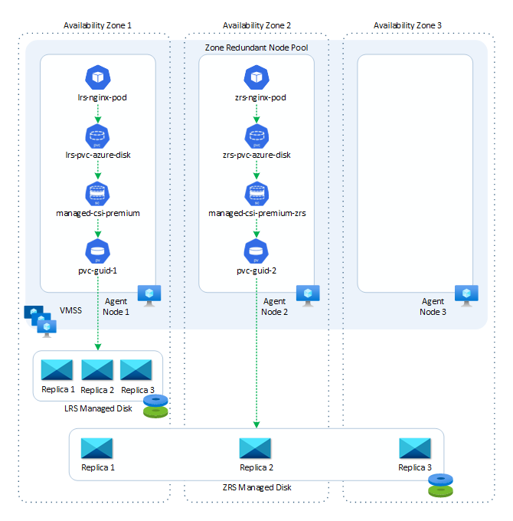
The diagram below illustrates how the pods are distributed across the agent nodes of a zone-redundant node pool, along with the corresponding Locally Redundant Storage (LRS) and Zone-Redundant Storage (ZRS) managed disks.

Slide 8
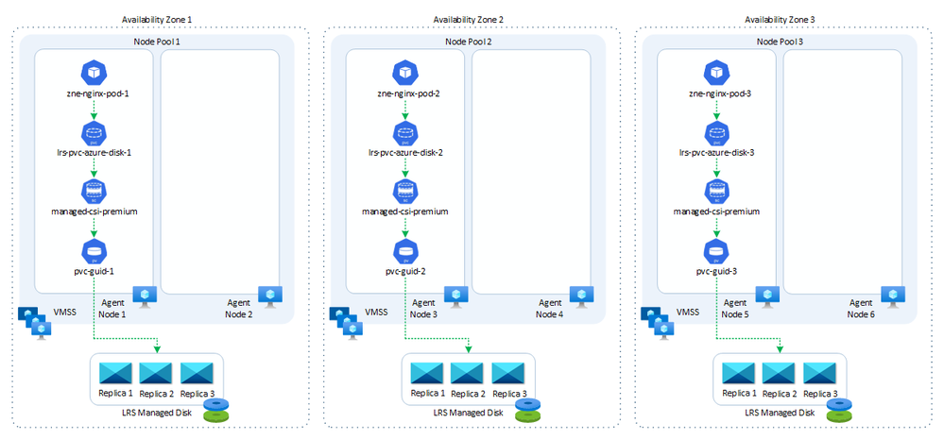
LRS Disk Based Solution

Slide 9
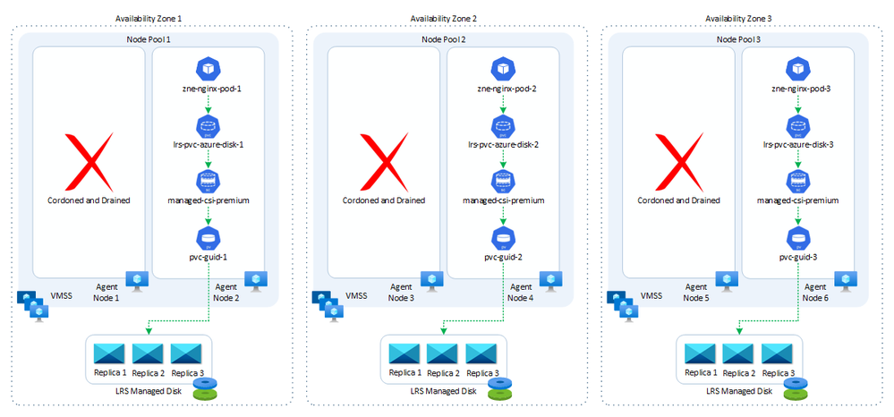
Node Failure with LRS

Slide 10
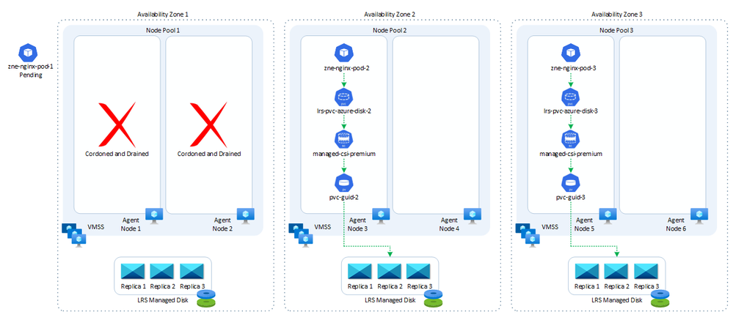
Zonal Failure with LRS

Slide 11
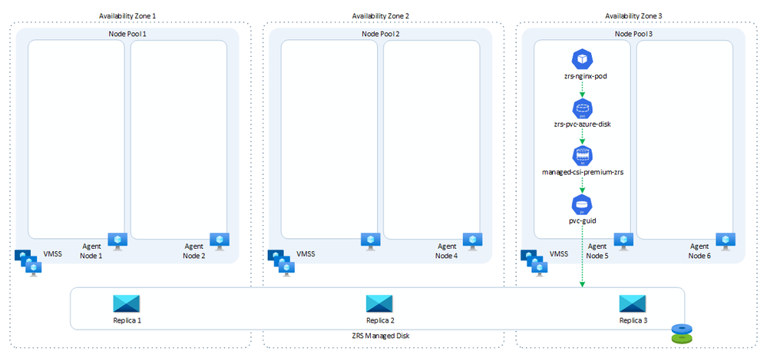
POD with ZRS

Slide 12
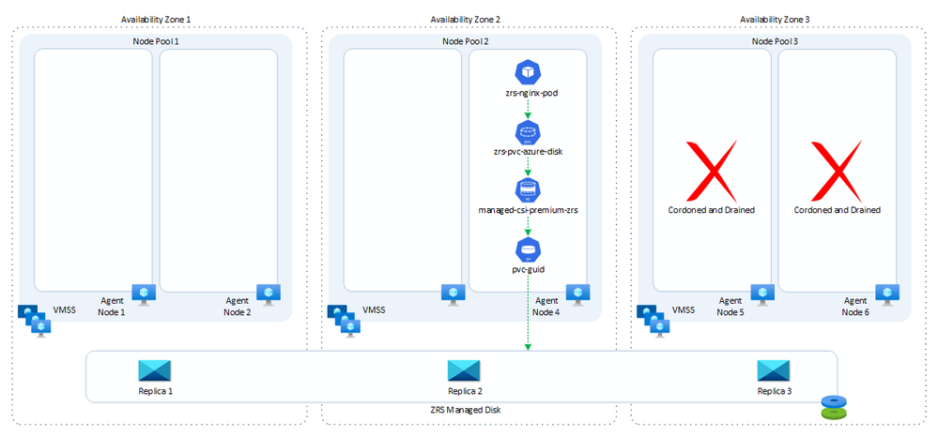
POD with ZRS in Case Zonal Failure

Slide 13
POD with ZRS and LRS
The diagram below illustrates how the pods are distributed across the agent nodes of a zone-redundant node pool, along with the corresponding Locally Redundant Storage (LRS) and Zone-Redundant Storage (ZRS) managed disks.

Slide 14
Persistent Volume- Azure Disk
Notes:
https://learn.microsoft.com/training/modules/introduction-to-azure-app-service/

Slide 15
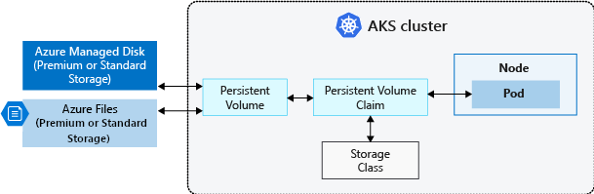
Persistent Volume in AKS

Slide 16
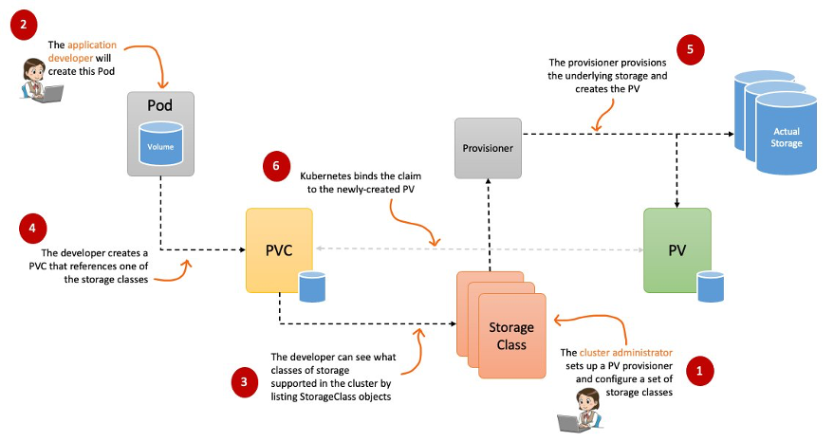
Persistent Volume Flow

Slide 17
Persistent Volume- NetApp File
Notes:
https://learn.microsoft.com/training/modules/introduction-to-azure-app-service/

Slide 18
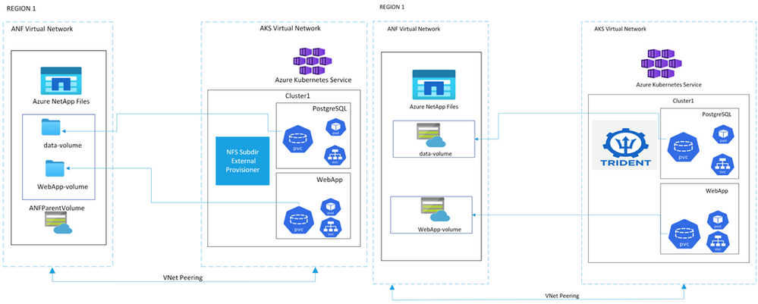
Azure NetApp File with persistent volume provisioner

Slide 19
Key Concept
Azure NetApp Files (ANF) is a shared first-party Azure file-storage service that is designed for running performance-intensive workloads on Azure. ANF volumes are created in capacity pools with a specific service level corresponding to a range of throughput capacities (16/64/128 MB/sec/TiB). Every volume takes an Azure virtual network (VNet) and a delegated subnet that it can be accessed on. Export policies further help in defining access rules for clients in the virtual network. In addition, volumes can be accessed over NFS, SMB, or both.
A Persistent Volume (PV) is “... a piece of storage in the cluster that has been provisioned by an administrator or dynamically provisioned using Storage Classes.” A PersistentVolume represents a logical unit of storage that maps back to an ANF volume.
StorageClasses are used to define multiple tiers of storage that can be used through Kubernetes to request for storage dynamically. Kubernetes administrators define storage classes that will be then used to create PersistentVolumeClaims.
A PersistentVolumeClaim (PVC) is a “... request for storage by a user”.
Notes:
https://techcommunity.microsoft.com/t5/azure-architecture-blog/comparing-and-contrasting-the-aks-anf-nfs-subdir-external/ba-p/3057547

